Slide 1

Milestone 3 Presentation
Brendan Madigan, Evan Ross, Hunter Hutchison, Cole Williams Garrett

Slide 2
Milestone 3 Goals
We wanted to implement the ability to change the output and input
Change and choose the directory in which our file is saved too
Change the duration of a recording sample

Slide 3
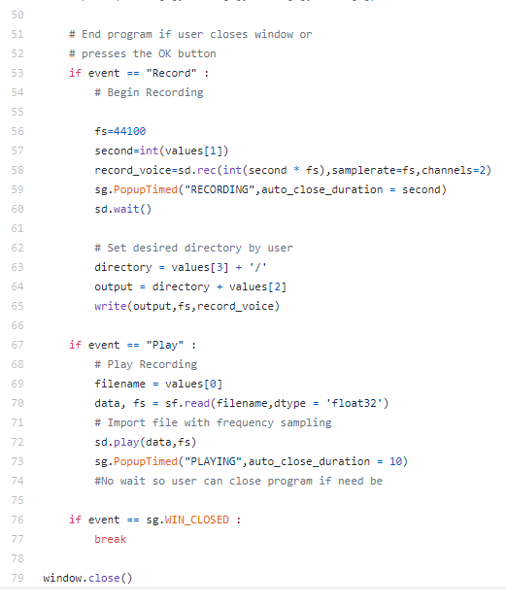
Milestone 3 Achieved Goals
The code was implemented correctly, and the goals were achieved
A program example is seen to the right

Slide 4

Milestone 3 Challenges
Python libraries were trouble to install during some durations of the milestone
These were solved by re-installing the libraries in combinations various times
The play button was reading from folders rather than files
This was fixed with a simple syntax change

Slide 5
Milestone 4 Expectations
For the final milestone, we want to have a fully functioning waveform generator.
This can be done through some code that we have researched.
The GUI will be updated
The elements of our repository will be more organized to reflect a good coding environment

Slide 6
Commit History
Evan Ross committed new files to help keep the librarie’s updated
Brendan Madigan committed a to change filename and directory
Hunter Hutchison updated main file and continued file selection
Brendan Madigan changed play to work with user’s browser
Cole Williams committed to change theme and add file

Slide 7
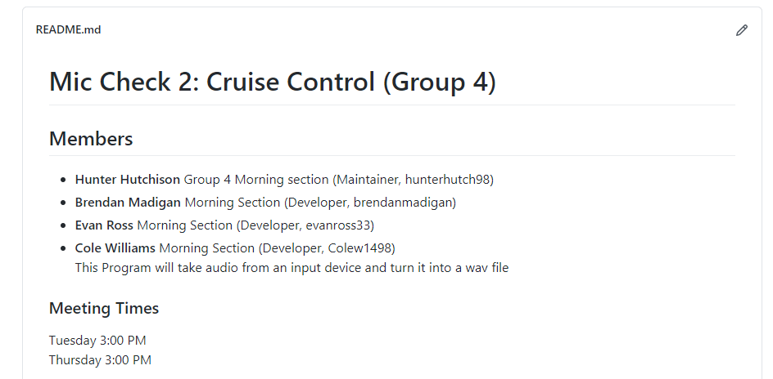
Github Repository
https://github.com/Mic-Check-2-Cruise-Control/root.git

